Slide 1
Obstacle avoidance for a differential drive robot
Project exam 2017

Slide 2
ED5-8-16
Project participants:
Philip Philev
Mihkel Soolep

Slide 3
Content of presentation

Slide 4
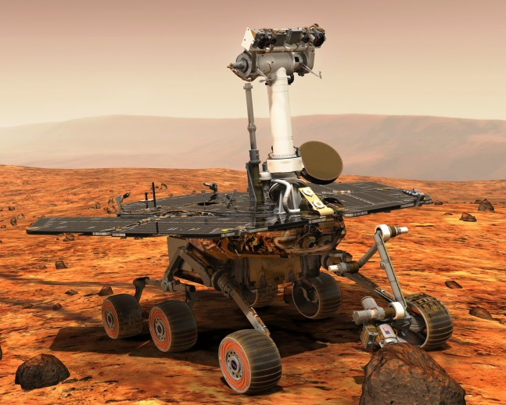
Background of topic choice
Increasing interest in the field of autonomous robotics, including vehicles and mobile robots.
Drastic decrease in prices for individual components.
- LIDAR, used in Google’s self-driving car project, was priced at 75.000$ in 2007.¹
- In 2017 Commercial LIDARs can be found for as low as 100$. Further price drop expected.
- Could result in increased interest from enthusiasts as well as developers.
Excellent way to obtain knowledge of the different
subsystems that compose an autonomous vehicle.
Large number of practical applications
Figure 1: Opportunity (Mars Exploration Rover – B)²

Slide 5
Differential wheeled robot
General idea behind the choice
Extensive use in robotics.
Low cost.
Adjustable for different applications.
Depending on size, can better manouver in closed spaces
Techical details
Two wheels controlled separately
Varying the rates of rotation of the wheels changes direction
Requires appropriate control to maintain a desired trajectory.

Slide 6
Desired implementations

Slide 7
Mathematical representation

Slide 8
Matlab implementation

Slide 9
Hardware used in development

